Slide 1

Object Oriented programming
Maheen Zahid BSCE22018
Maryam Aftab BSCE22031
Muhammad Miqdad Ahmad BSCE22001

Slide 2
Problem statement
We are required to create a two-player chess game that also stores the data of the players in files.

Slide 3
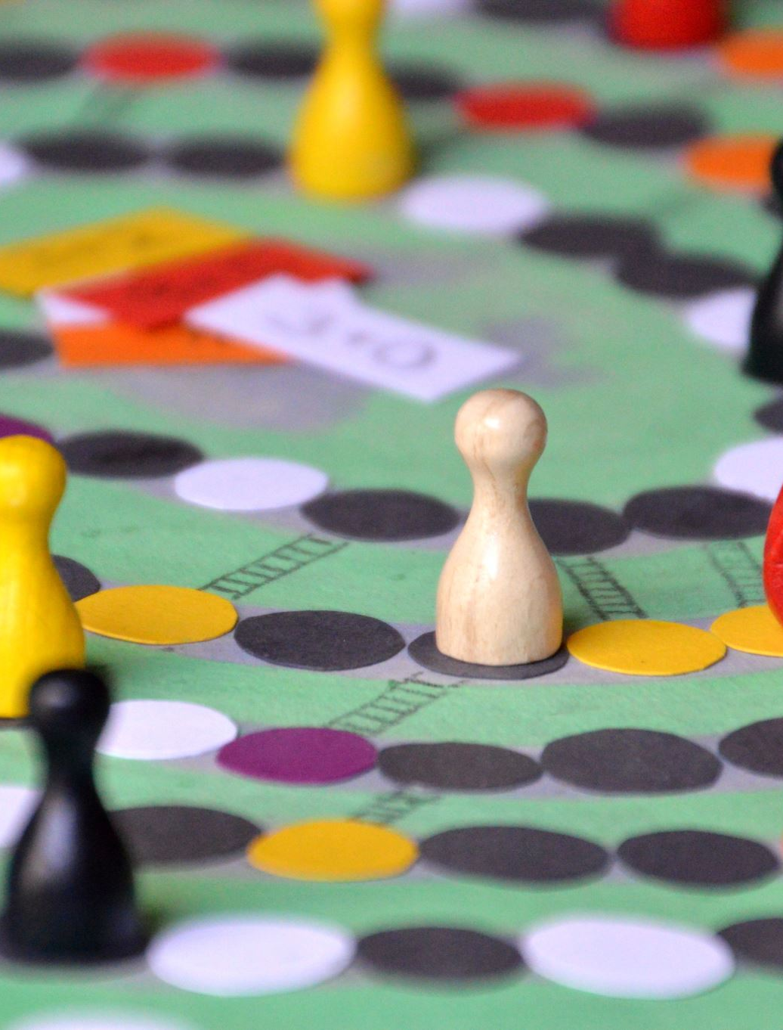
Solution approach
We created four classes that made our login system
And then nine other classes that were responsible of operating the game.

Slide 4

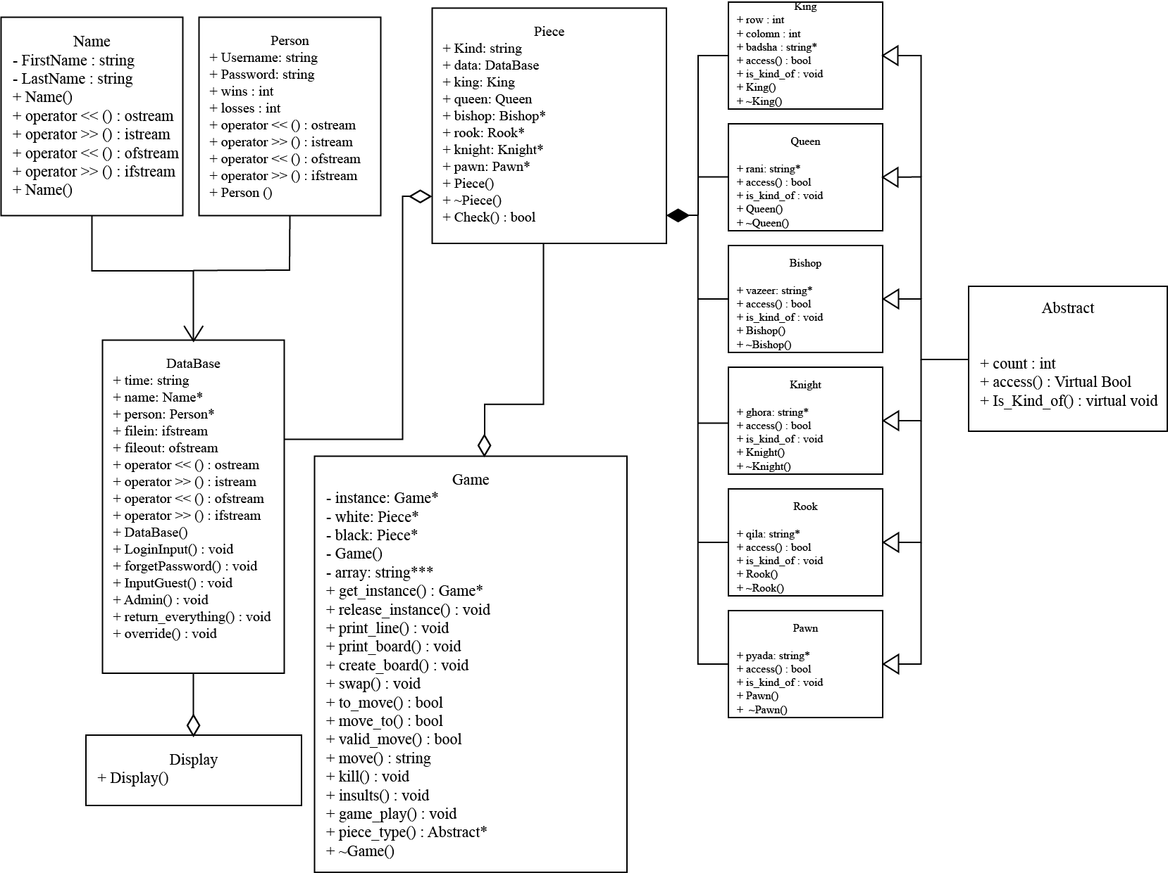
Chess UML

Slide 5

Log in system
There were four classes that made our login system

Slide 6

Name and Person
The name and person classes that were responsible for taking the name and the data of the users and were associated into the database class
The Database class was aggregated into piece

Slide 7
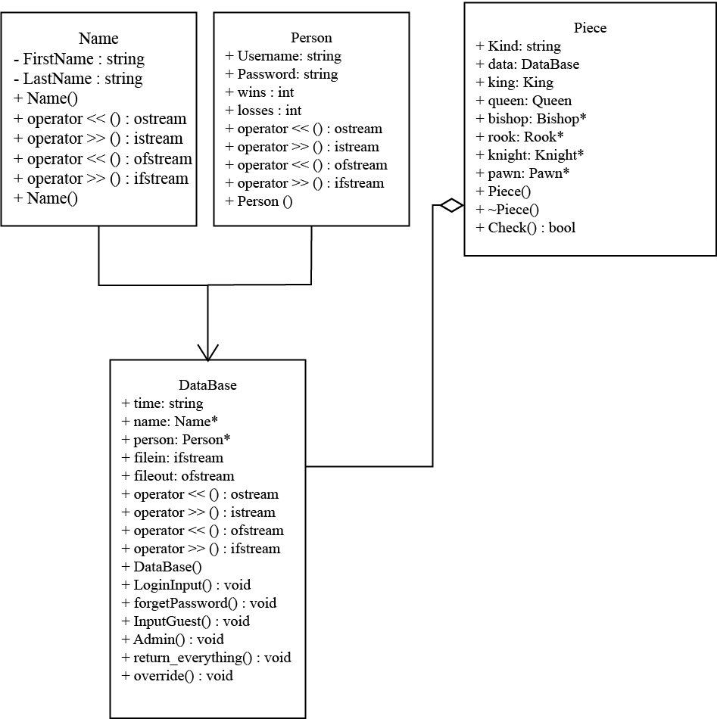
Aggregation & Association

Slide 8

Display
This was the template class that we used to display the information of the users
DataBase was aggregated into this class

Slide 9
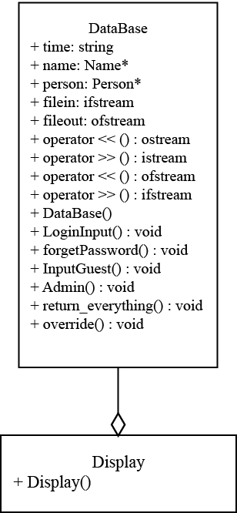
Display Aggregation

Slide 10

Game
There was a base class called abstract that contained all the functions that were responsible for playing the whole game.
All the classes that represented the pieces inherited the base class.
The base class had the functions that were responsible of restricting the moves of the pieces.

Slide 11
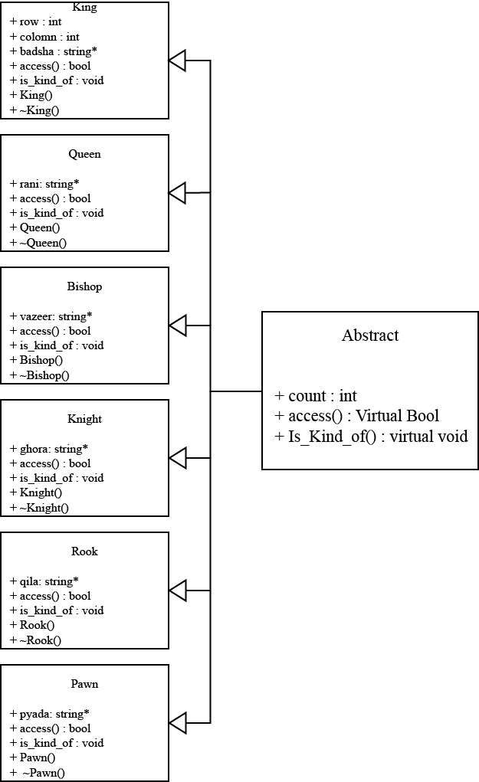
Base and inherited classes

Slide 12

Game
All the chess pieces were made from printing emojis
They were stored in string arrays.
And then the dynamically allocated memory was deleted in the destructors of the respective classes.

Slide 13
Game
All the classes representing the pieces were then composed into a single class piece.

Slide 14
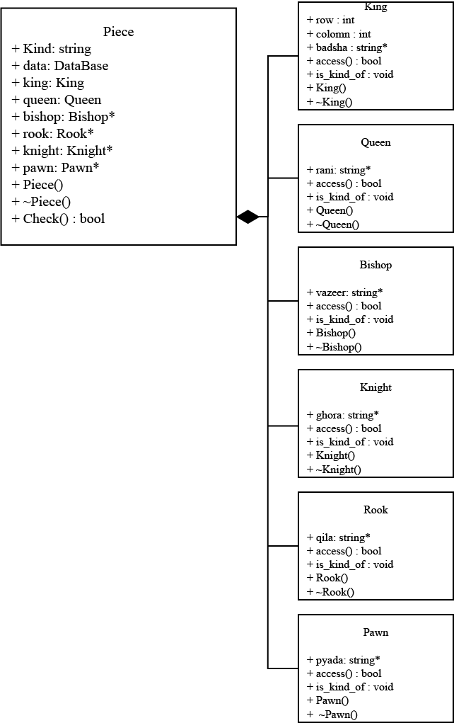
Composition

Slide 15

Game
The piece class was then aggregated into the Game class. Two instances were created that represented the white and the black pieces, respectively.
In this class we used a string triple pointer to create an array that represented the board of the game.
This was a singleton class.

Slide 16
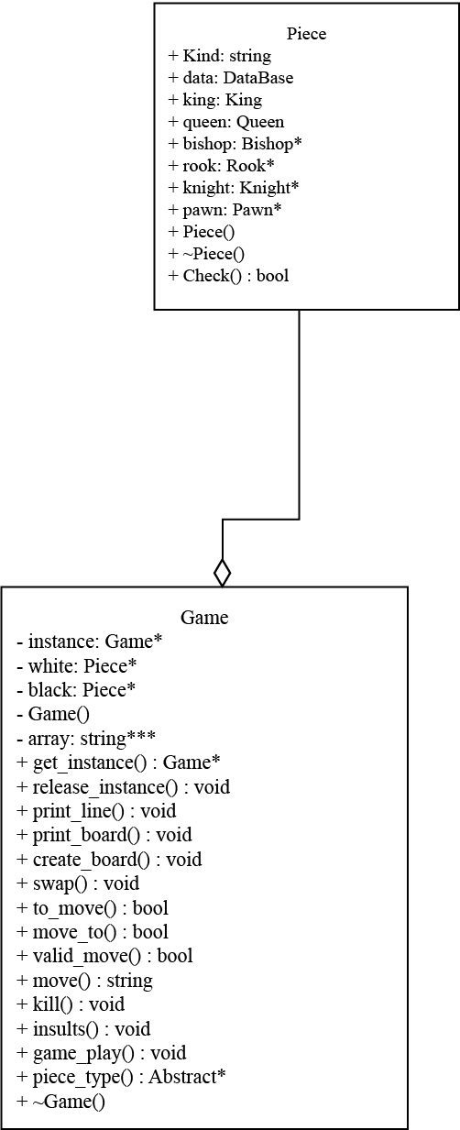
Aggregation

